Slide 1
FORECASTING THE YIELD CURVE
Guillermo Marin Bull
Dhruv Chakervarti
Naveen Varma Chekuri
Aadithya Narayanan
Advisor: Professor Francis Longstaff
Company: Western Asset Management

Slide 2
AGENDA
Project Description
Introduction
Data
Implementation
Economic Parameters
Result
Conclusion

Slide 3
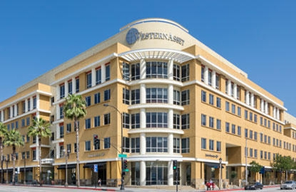
PROJECT DESCRIPTION
Explain and forecast yield curve changes of the UST sovereign yield curve across maturities, using economic and financial data
Forecasts for the changes in the yield curve should be made for 1, 3, 6 and 12 months.

Slide 4
INTRODUCTION
A crucial part of managing any fixed income portfolio is projecting yield curve changes.
Opinions on the yield curve help position the portfolios strategically to capture alpha.
Forecasting movements in the term structure is of prime importance to active fixed income portfolio managers, who would attempt to time the market, and adjust the positions in their portfolio to take advantage of market events.

Slide 5
INTRODUCTION
The term structure, or the yield curve is composed of Treasury bonds of varying tenors all of which may not move in tandem. However, a singular value decomposition yields three possible vectors that explain close to 99.5% of the variation.
These Principal Components can be interpreted as the level, slope and curvature factors in the yield curve.

Slide 6
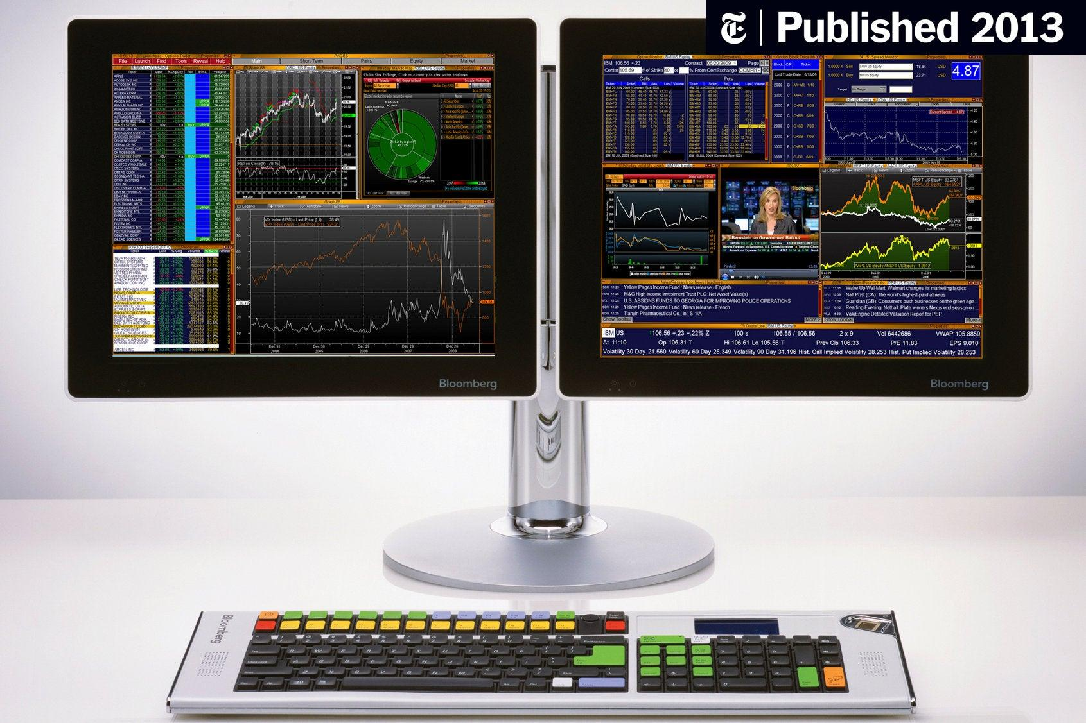
REQUIRED DATA
T-strip yields data (Bloomberg)
Sell Side analyst consensus on expected economic outcomes (Bloomberg)
Macroeconomic data (Bloomberg)

Slide 7
THEORETICAL BACKGROUND
Diebold & Li (2003) proposes the construction of a parametric equation similar to Nelson-Siegel, with the Betas interpreted as the PCA factors.
Furthermore, combining lagged factors can be used into predicting futures values of them. As there is also causality between the factors, the interactions between this factors is useful for predicting purposes.
This conclusion leads to constructing a Vector Autoregressive Model (VAR) where we will try to predict future values of a factor by a combination of lagged betas.

Slide 8
IMPLEMENTATION
The Betas are constructed using the yield data extracted from Bloomberg as input, with the Diebold & Li methodology and the inclusion of one extra Beta to account for the long-term curvature
The lambdas that define the humps capturing the short term and long-term effects for the yield curve equation are obtained from positioning the humps of the yield curve at 30 and 180 months.
Using these parameters in the modified Diebold & Li equation gives approximated yields for all maturities. Using this equation we constructed weekly yield curves between 03-2007 and 09-2020

Slide 9
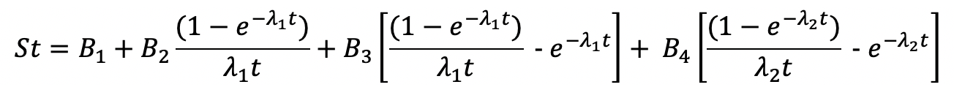
IMPLEMENTATION
Using this extra lambda, we constructed a 4 factor model (in order to apply the 2nd hump present on the yield curve):

Slide 10
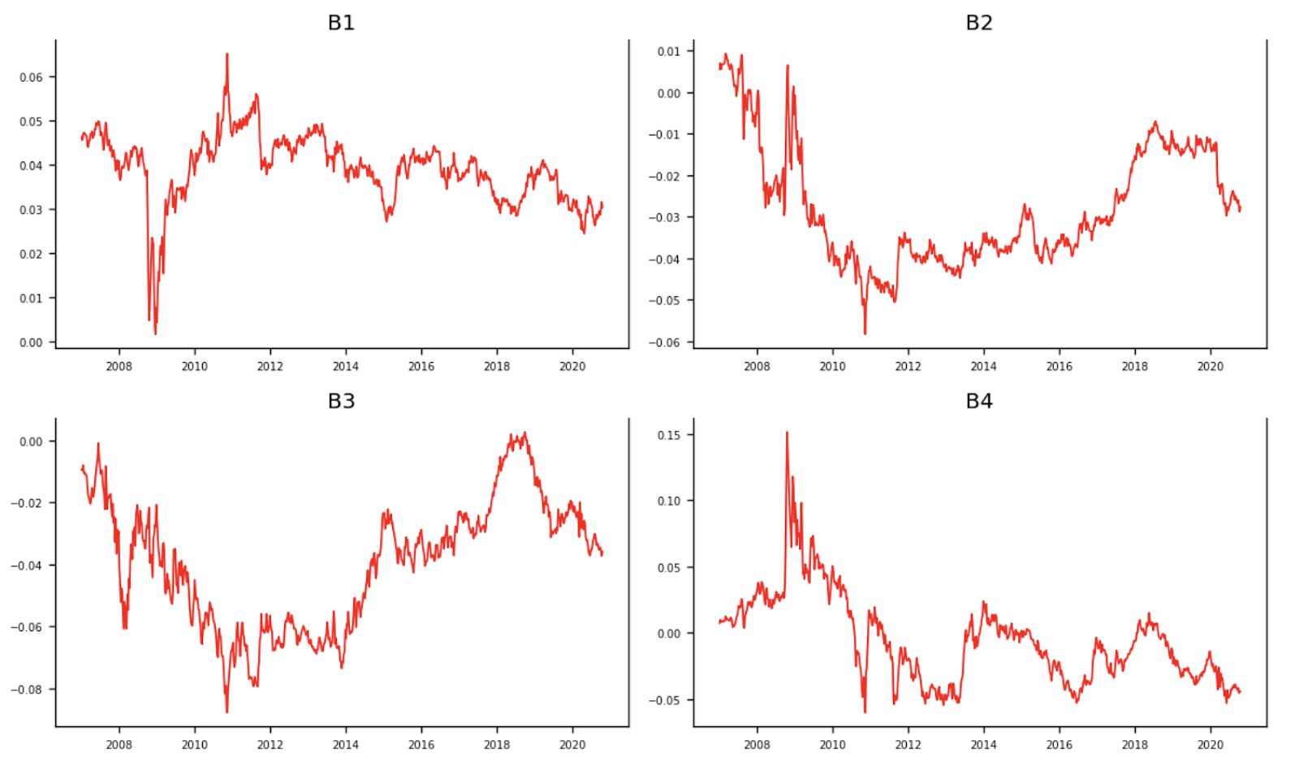
IMPLEMENTATION
Fitting this model into the data, we obtained the time series of each of the 4 factors:

Slide 11
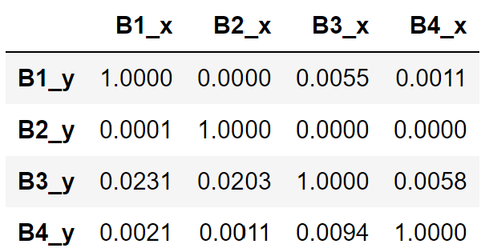
IMPLEMENTATION
We do the Granger causality test on the 4 betas of Nelson Siegel Svensson model to check the dependence of the one on others.
The below matrix showcases the how much of one beta is explained by others.

Slide 12
IMPLEMENTATION – VAR LAGS
To determine the number of lags in the VAR model on the betas, we employ AIC (Akaike information criterion) test.
We find that the VAR is best performed at 1 lag.
Once we have the VAR model with the 4 betas, we have a model to predict the betas into the future.
From the predicted betas we get the yields using the Nelson Siegel Svensson model.

Slide 13
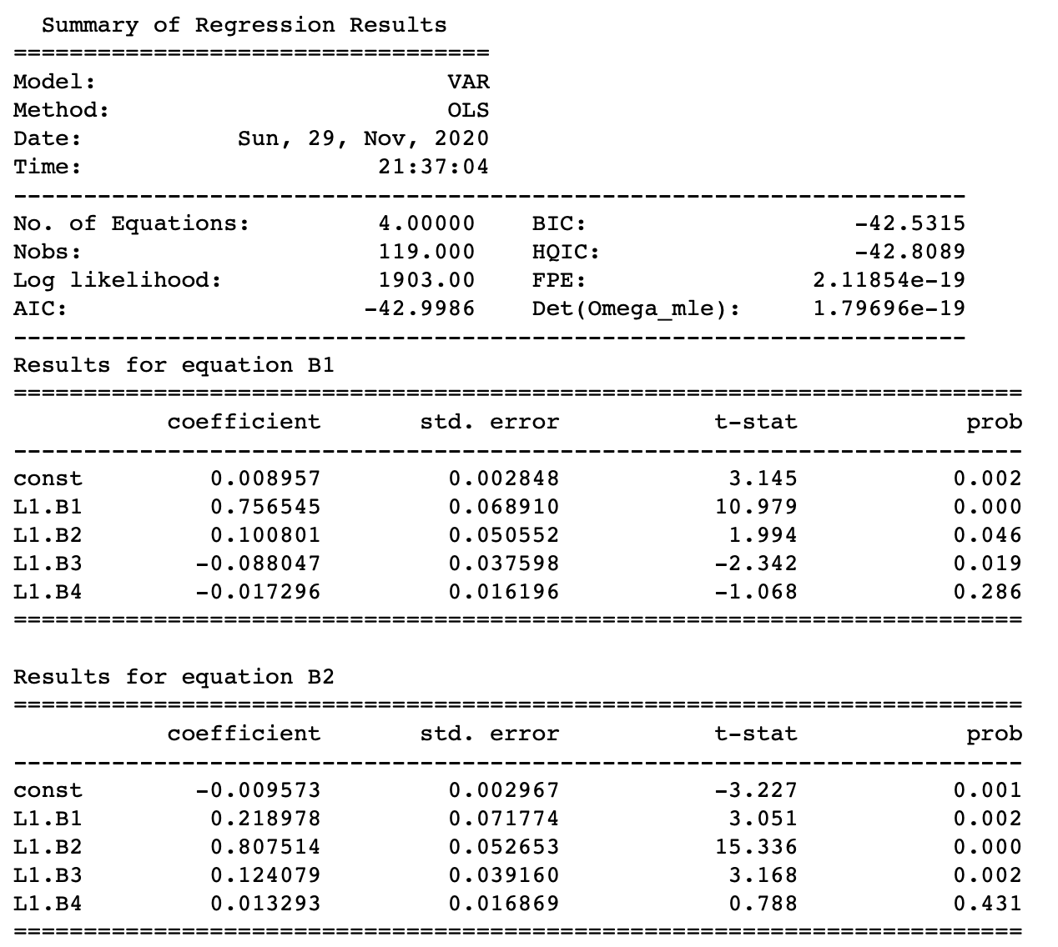
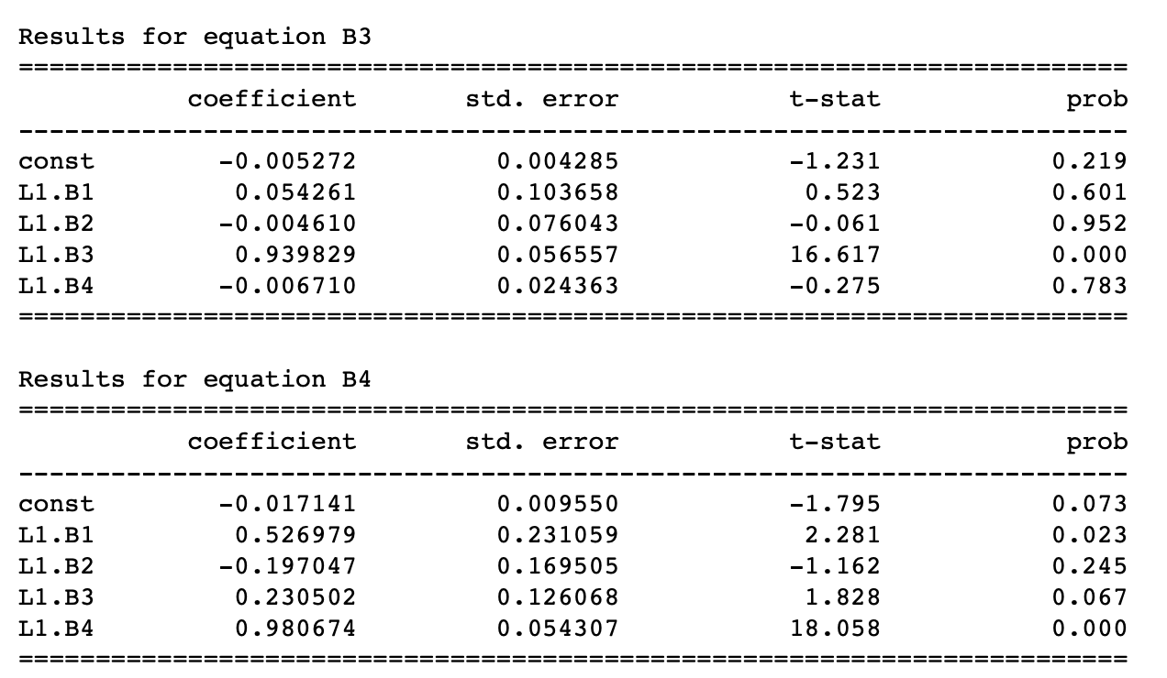
VAR RESULTS

Slide 14
IMPLEMENTATION – ECONOMIC PARAMETERS
We tried to include the economic parameters like money supply, CPI, industrial production change, unemployment rate and GDP in the VAR for betas but found that their coefficients are very insignificant in predicting betas.
As such we have omitted the economic variables from our VAR for betas.

Slide 15
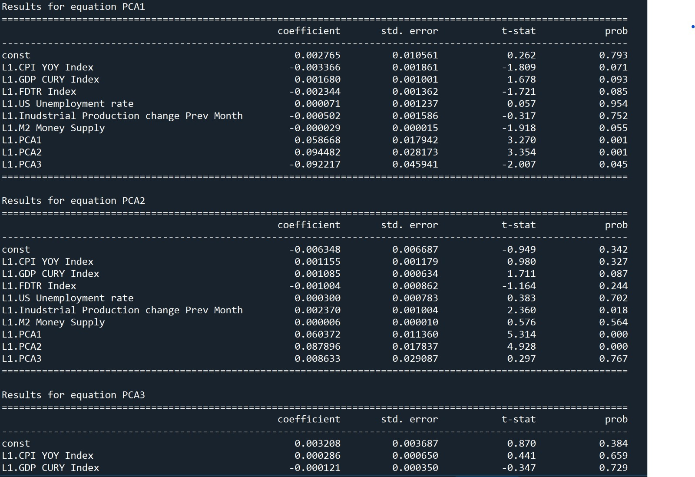
IMPLEMENTATION – ECONOMIC PARAMETERS

Slide 16
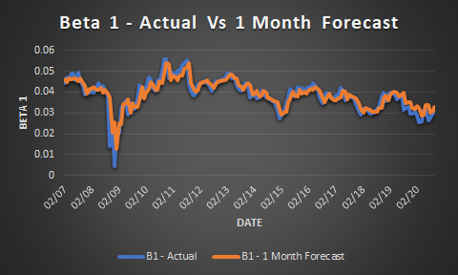
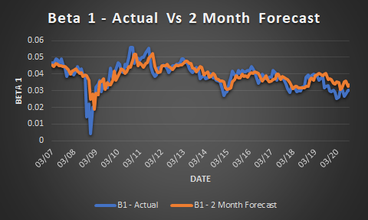
RESULTS FOR B1~LEVEL
We plot the projected Vs actual betas and see that both the plots overlap and that the prediction is working.

Slide 17
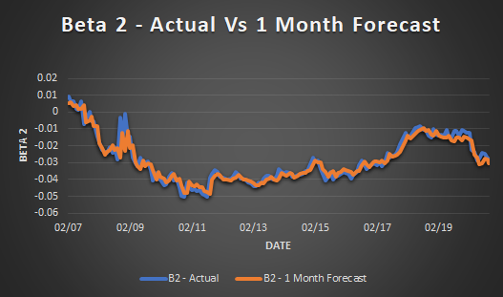
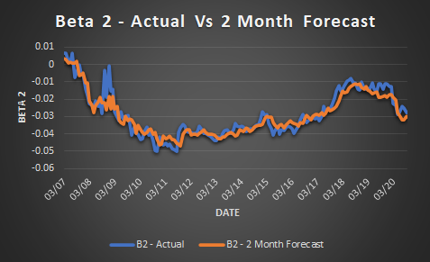
RESULTS FOR B2~SLOPE

Slide 18
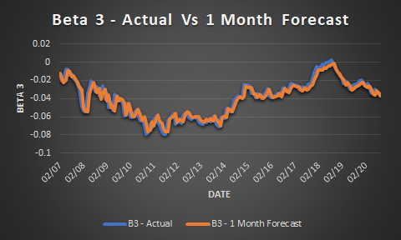
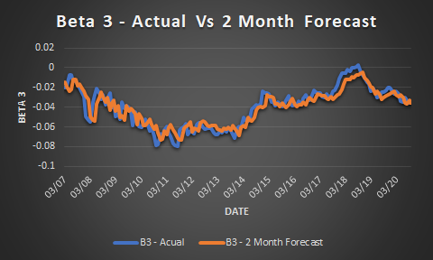
RESULTS FOR B3~MID TERM CURVATURE

Slide 19
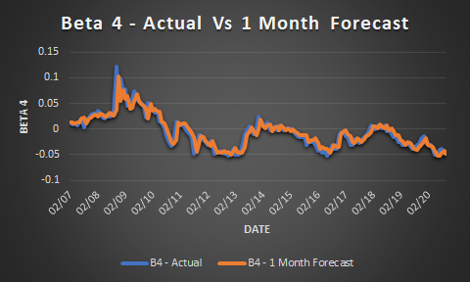
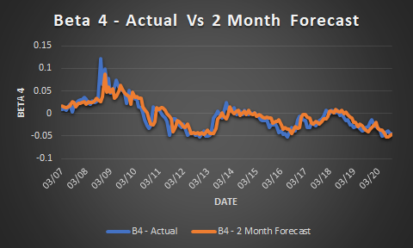
RESULTS FOR B4~LONG TERM CURVATURE

Slide 20
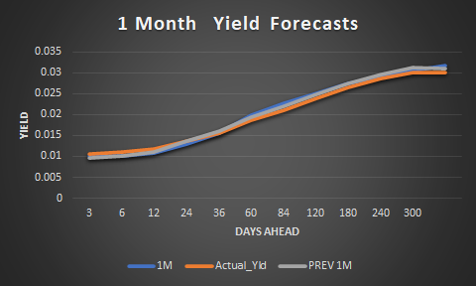
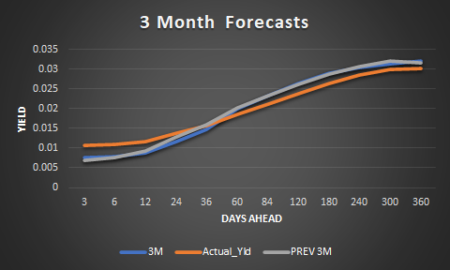
Yield Forecasts
As of 05/31/2017

Slide 21
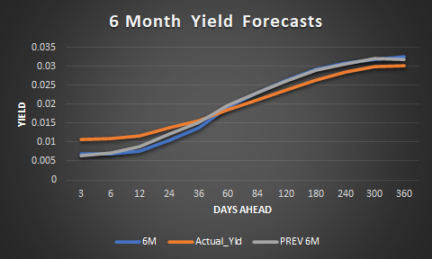
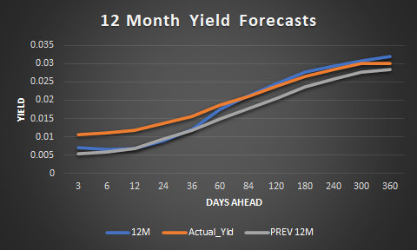
Yield Forecasts
As of 05/31/2017

Slide 22
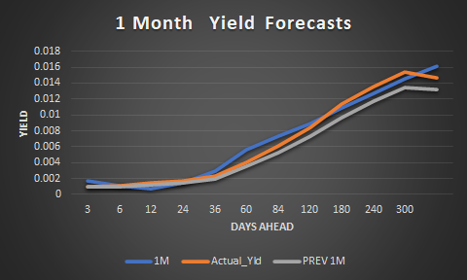
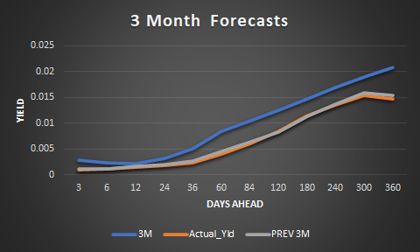
Yield Forecasts
As of 08/26/2020

Slide 23
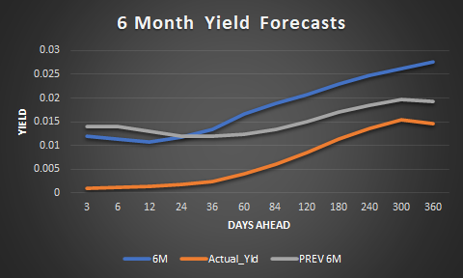
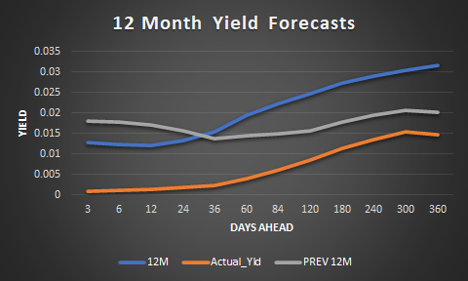
Yield Forecasts
As of 08/26/2020

Slide 24
CONCLUSIONS
As per our observation of the in-sample forecasts:
For the beta coefficients, we observe that the model provides accurate predictions.
The model is capable of accurately predicting yield curve movements in the shorter term. The predictions for longer term show higher dispersion, especially in unprecedented times of extreme economic movements, for instance the pandemic. However, when the economy is stable, the model does incorporate micro changes and predict the longer term movements in the yields relatively well.
Predicting Yield curve continues to be a guessing game!!

